Slide 1
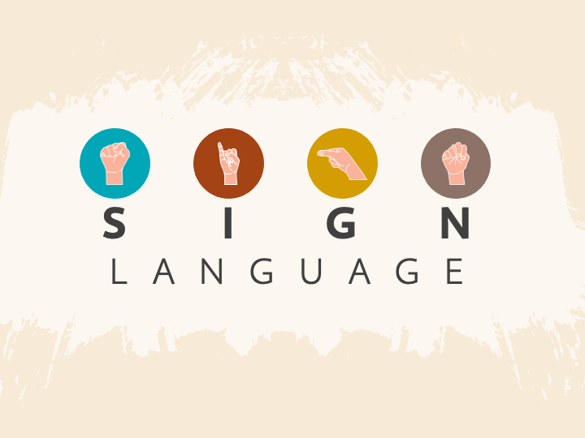

R E C O G N I T I O N

Slide 2
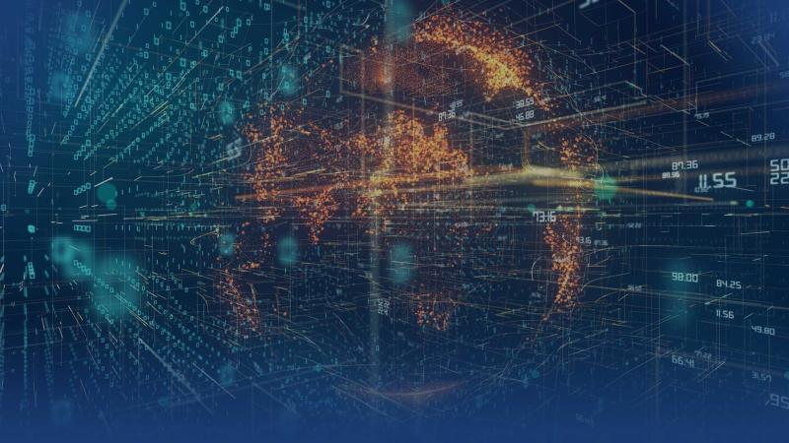
KOLHAPUR INSTITUTE OF TECHNOLOGY’S COLLEGE OF ENGINEERING DEPARTMENT OF CSE-AIML & DS DATA STRUCTURE PBL :
Under the guidance of Ms. Uma P. Gurav and
Ms. Komal Jadhav
Team Members :
ONKAR GIRI. (PRN: 2223000130)
VIRAJ MULIK. (PRN: 2223000406)
SHREYA CHAVAN. (PRN: 2223000796)
DIGVIJAY PAWAR. (PRN: 2223000399)

Slide 3
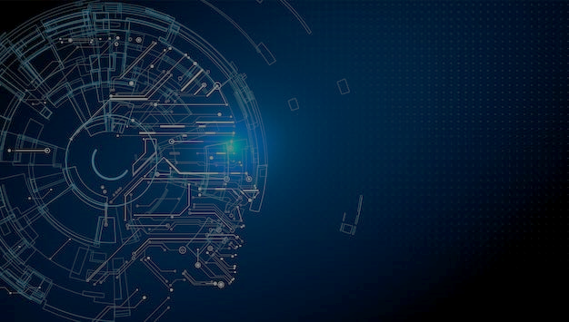
CONTENTS :
Introduction
Methodology
System Architecture
Implementation
Advantages and Disadvantages
Conclusion

Slide 4
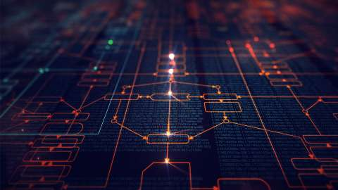
INTRODUCTION :
Communication is the main channel to interact between individuals with each other.
A gesture is the Non-verbal communication in which visible body communicates particular message.
Motion of the body that contains information.
Gesture include movements of hands, face or other parts of body.
Gesture is distinct from sign language.
The seminar explains how hand gestures can be translated into text.
Reading hand gesture is one way of improving human-computer interaction using camera and computer vision.

Slide 5


METHODOLOGY :
Creating A Image Dataset
Hand
Segmentation
Model Training
Camera Captured Video
Dividing Video into Images
Tracking + Boundary Identification
Trained Model Database
Raw Images
Training Phase
Testing Phase
Frame Capture
Hand Segmentation
Gesture Classification
Display
Text Output

Slide 6
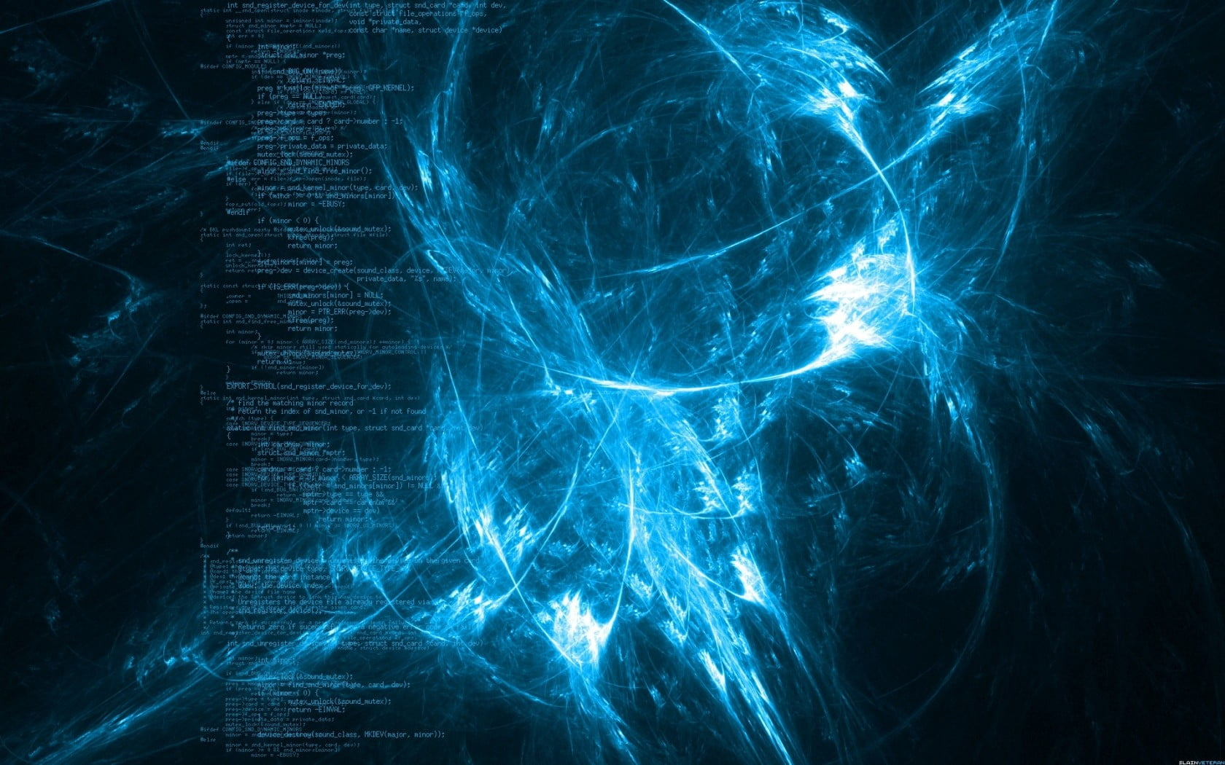
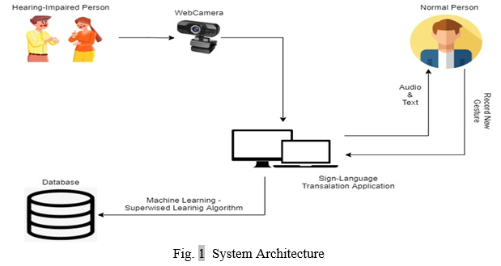
SYSTEM ARCHITECTURE :
The figure shows the system architecture of the system, which basically shows component of the system, system work and the process flow.

Slide 7

IMPLEMENTATION :
Image Pre-processing :
The captured objects are being pre-processed. Pre-processing
is done to remove the extra objects.
Feature Extraction And Recognition :
An algorithm is used to determine an images characteristic.
To retrieve the best featured image from the database, the
algorithm applied to the captured image.

Slide 8

DISADVANTAGES :
ADVANTAGES :
Useful for deaf and dumb people.
Quick expressing of message.
People can easily interpret the gesture of another person.
Used in sign language translation.
Some gestures are difficult to understanding information might get distorted.
Can not make long explanation or conversation through it.
It is one of the type of informal communication , where it is not suited for official purpose.

Slide 9
CONCLUSION :
This method has used images to discuss the gestures classification to recognition of gestures.
The solution in this paper depends entirely on the shape parameters of the hand gesture.
Sign Language Recognition System has been developed for classifying only static signs and alphabets, to the system that can successfully recognize dynamic movements that comes in continuous sequences of images.

Slide 10


